Slide 1
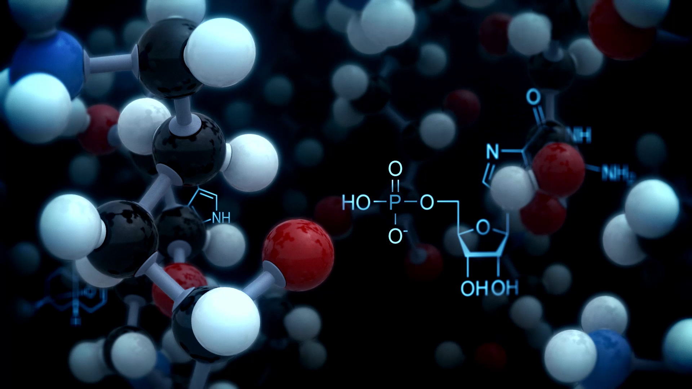

Molecules in 3D space
Paweł Dąbrowski-Tumański
MiNI Lecture, Definitely Winter 2026

Slide 2

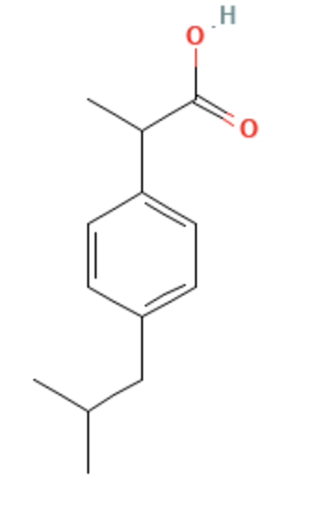
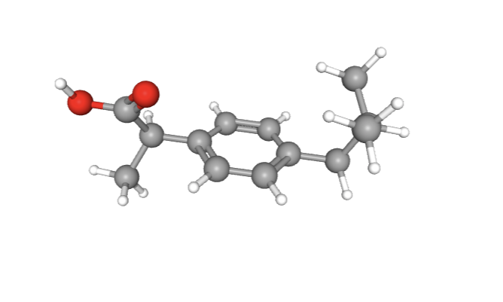
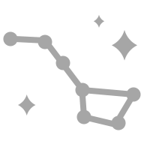



FROM 2D TO 3D
🧬 3D structure is critical for binding analysis

Slide 3
LIGANDS IN BIOLOGY
💊 Small molecules: drugs, metabolites
🧬 Peptides: signaling or regulatory molecules
⚡ Ions: metal cofactors and charge interactions
🌐 Ligand diversity affects binding strategies

Slide 4
WHAT CAN LIGANDS INTERACT WITH?
🧬 Proteins: enzymes, receptors, transporters
🧪 Nucleic acids: DNA and RNA binding
🛡️ Membranes and lipids
⚛️ Other small molecules or cofactors

Slide 5
BIOLOGICAL CONSEQUENCES OF BINDING
⚡ Activation of enzymes or receptors
🛑 Inhibition or blocking of function
🔄 Signaling cascade modulation
🧩 Regulation of metabolic pathways

Slide 6
SPECIFICITY VS NON-SPECIFIC BINDING
🎯 Specific binding ensures functional relevance
❌ Non-specific binding can cause off-target effects
🔍 Shape and chemical complementarity drive specificity

Slide 7
IMPORTANCE IN DRUG DISCOVERY
💻 Predict interactions computationally
📈 Prioritize ligands for experiments
🧬 Reduce cost and time in drug design
🧠 Bridge structural data to functional predictions

Slide 8
CONCEPT OF MOLECULAR RECOGNITION
🔗 Ligand fits its target via complementary interactions
🧪 Governed by physics: H-bonds, hydrophobicity, electrostatics
🎯 Determines specificity and biological outcome

Slide 9

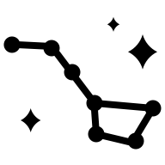
FROM SMILES TO 3D CONFORMATIONS
📝 Convert linear or fingerprint representations to 3D structure
🔗 Enables docking and interaction analysis
💻 Computational methods generate coordinates from SMILES

Slide 10
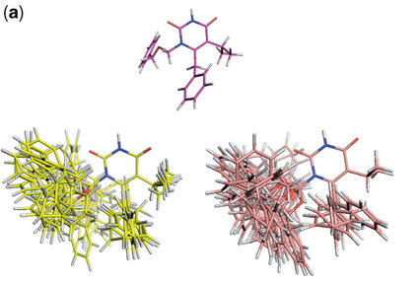
WHY MOLECULES ARE NOT STATIC

Slide 11
WHY MOLECULES ARE NOT STATIC
🔄 Molecules adopt multiple shapes due to rotatable bonds
⚖️ Flexibility affects binding and energy landscapes
💡 Single static conformation is rarely sufficient

Slide 12
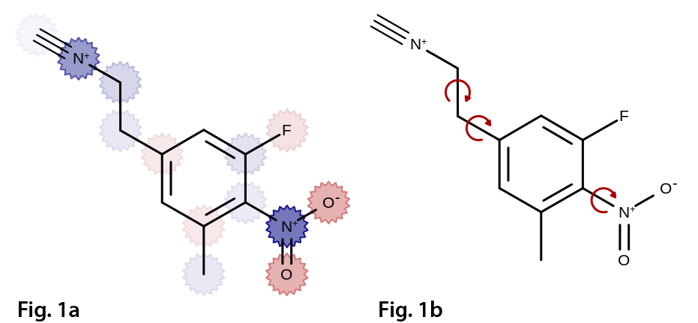
ROTATABLE BONDS

Slide 13
ROTATABLE BONDS
🔗 Each rotatable bond adds a torsional degree of freedom
📈 Number of conformations grows exponentially
🧮 Important for sampling in docking algorithms

Slide 14
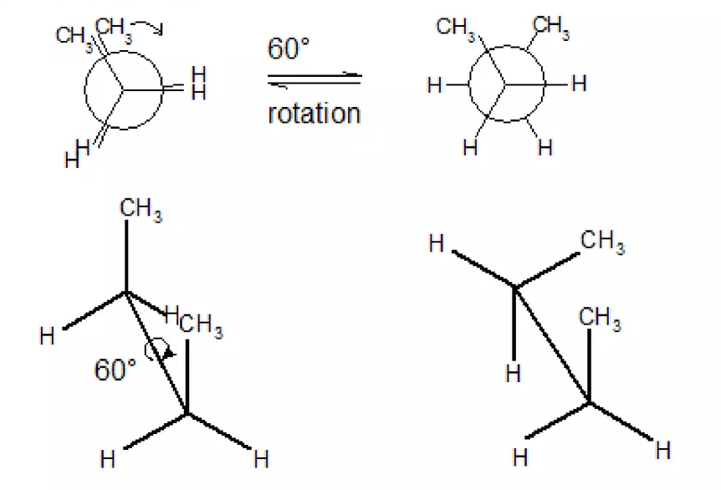
ROTAMERS

Slide 15
CONFORMATION GENERATION
⚛️ Use classical force fields to predict stable conformations
💡 MMFF and UFF are widely used in cheminformatics
🖥️ Energy minimization finds low-energy geometries

Slide 16
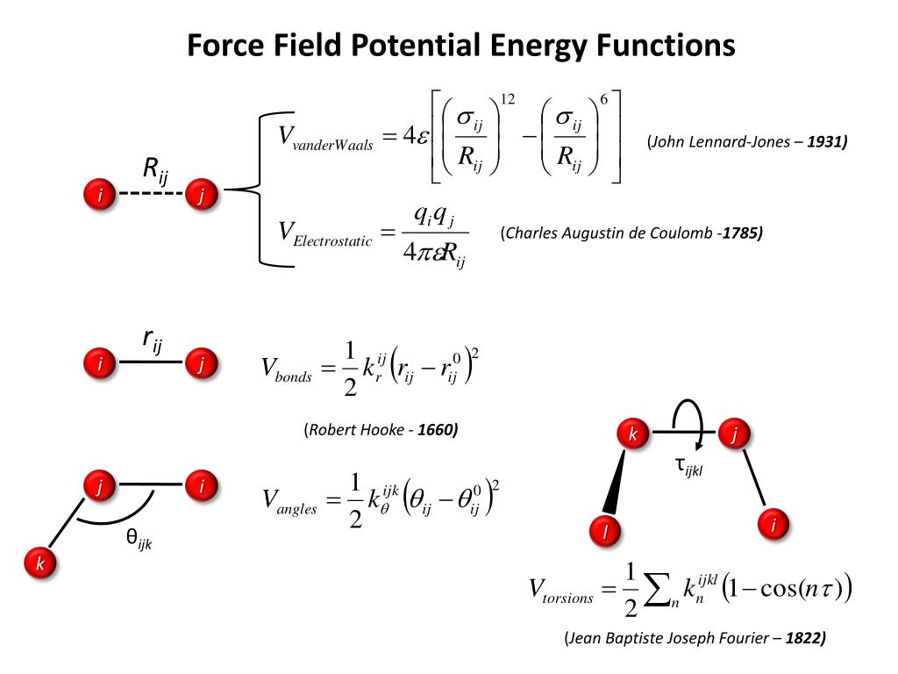
CONFORMATION GENERATION

Slide 17
ML-BASED FORCE FIELDS FOR MOLECULES
🤖 Machine learning predicts energy and geometry
⚡ Often faster than traditional force fields
📊 Can capture subtle electronic effects

Slide 18
DISTANCE GEOMETRY
📏 Build 3D coordinates from distance constraints
🔄 Generates multiple plausible conformers
🧮 Useful for flexible docking and energy analysis

Slide 19
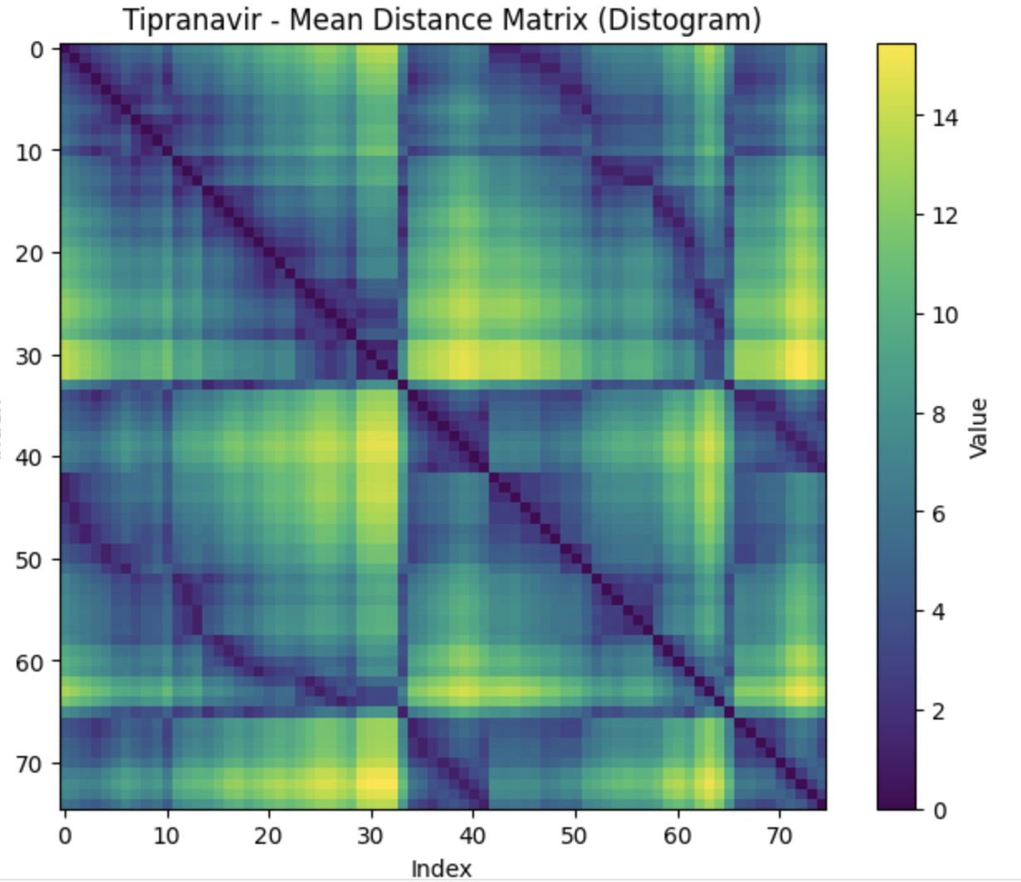
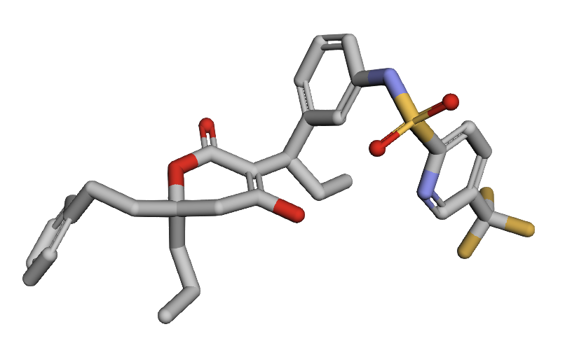
DISTANCE GEOMETRY

Slide 20
ENERGY MINIMIZATION APPROACHES
⚖️ Refine 3D structures to local energy minima
💻 Gradient-based optimization is common
🧩 Reduces unrealistic bond lengths and angles

Slide 21
CONFORMER ENSEMBLES
🔄 Multiple low-energy conformations represent flexibility
⚖️ Used to capture realistic binding possibilities
📊 Ensembles improve docking and similarity calculations

Slide 22
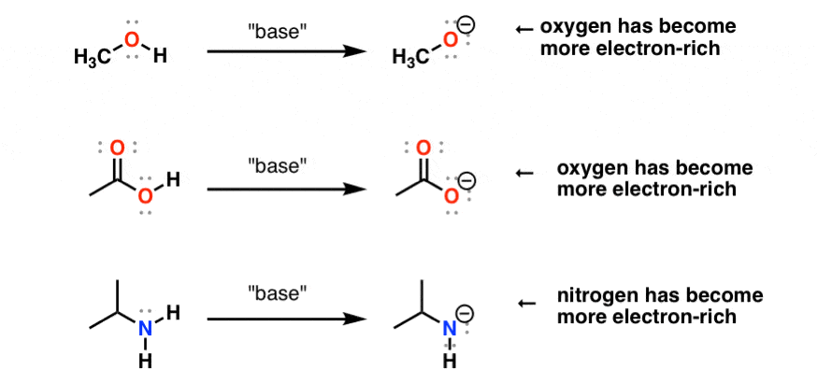
PROTONATION STATES

Slide 23
PROTONATION STATES
⚡ Protonation affects H-bond donors/acceptors
🌡️ pH can change ligand charge state
🧮 Algorithms can enumerate multiple protonation states

Slide 24
TAUTOMERISM AND RESONANCE FORMS
🔄 Different tautomers can bind differently
💡 Enumerating tautomers is important for docking
⚛️ Resonance affects electronic distribution

Slide 25
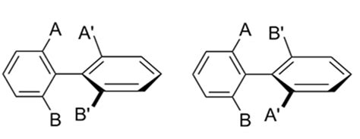
ATROPISOMERISM AND AXIAL CHIRALITY

Slide 26
ATROPISOMERISM AND AXIAL CHIRALITY
🌀 Axial chirality affects binding orientation
⚖️ Stable atropisomers must be considered in docking
🔍 Computational prediction guides experimental validation

Slide 27
QM AND NMR APPROACHES
⚛️ Quantum mechanics predicts accurate geometries
🧪 NMR gives experimental conformational data
📊 Useful for benchmarking computational methods

Slide 28
SOLVENT EFFECTS
💧 Solvent can stabilize certain conformers
🖥️ Implicit vs explicit solvent models
⚖️ Important for realistic docking simulations

Slide 29
3D DESCRIPTORS
🎯 Encode H-bond donors/acceptors, hydrophobic centers
🧩 Capture pharmacophore patterns for similarity
💡 Supports docking and virtual screening

Slide 30
RMSD: ROOT-MEAN-SQUARE DEVIATION
📏 Measures average atomic displacement between structures
🔍 Widely used for comparing conformations
⚠️ Sensitive to alignment and outliers

Slide 31
LIMITATIONS OF RMSD
⚠️ Ignores chemical context of atoms
🔄 Cannot capture functional similarity
💡 Alternative metrics may be more informative

Slide 32
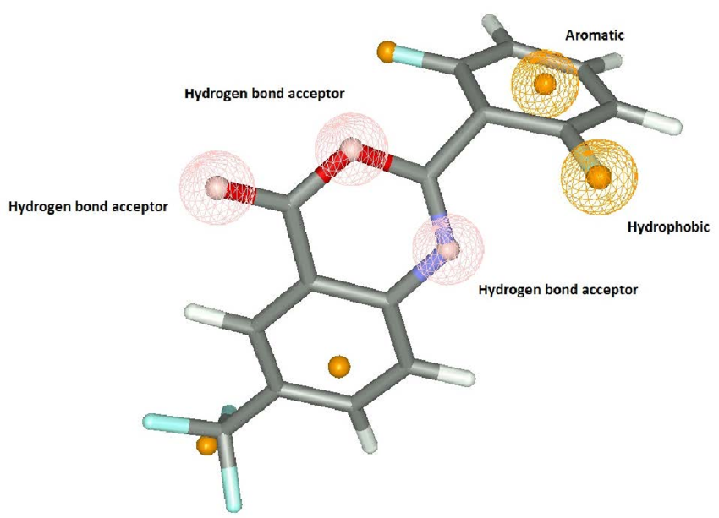
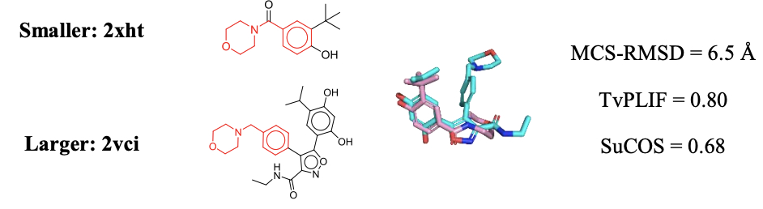
SUCOS METRIC FOR OVERLAP
🎯 Localization of features in 3D

Slide 33
SUCOS METRIC FOR OVERLAP
🔗 Measures 3D overlap of molecules and interactions
🎯 Combines shape and pharmacophore features
💡 Useful for docking pose evaluation

Slide 34
PHARMACOPHORE FINGERPRINTS

Slide 35
PHARMACOPHORE FINGERPRINTS
🎯 Encode spatial arrangement of key functional groups
🔍 Compare molecules beyond simple RMSD
💻 Supports virtual screening and similarity search

Slide 36
COMPARING DOCKED VS EXPERIMENTAL
🔍 Evaluate docking accuracy
📏 Use RMSD or SuCOS for comparison
⚖️ Guides scoring and model improvement

Slide 37
IMPLICATIONS OF STRUCTURAL SIMILARITY
🎯 Similar conformers likely to bind similarly
⚖️ Structural diversity affects docking success
💡 Embedding multiple conformers improves predictions

Slide 38
CONCEPT OF ENERGY LANDSCAPE
🗻 Ligand conformations correspond to points on an energy surface
⚖️ Low-energy states are more probable
🔄 Determines accessible conformations for binding

Slide 39
LOCAL MINIMA AND GLOBAL MINIMUM
⚡ Local minima: stable conformations
🏔️ Global minimum: lowest energy state
🧩 Important for docking and molecular simulations

Slide 40
BOLTZMANN DISTRIBUTION
📊 Probability of a conformation depends on energy
⚖️ High-energy conformers less populated
🔍 Guides which structures to prioritize for docking

Slide 41
VISUALIZING CONFORMATIONAL ENERGY
🗻 Energy vs conformation plots
🔍 Identify accessible regions and barriers
💡 Supports sampling strategy design

Slide 42
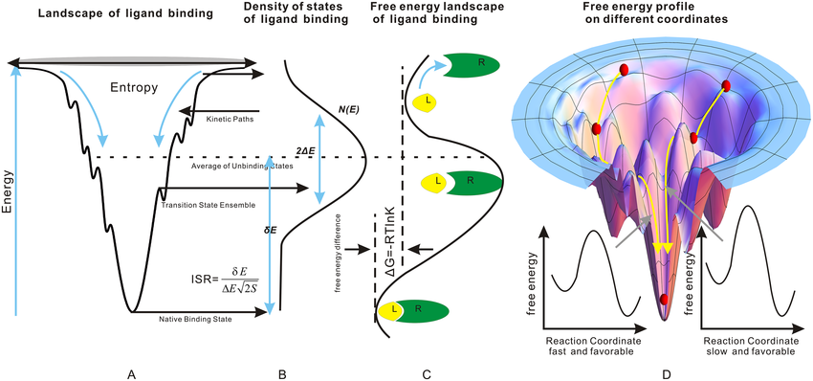
VISUALIZING CONFORMATIONAL ENERGY

Slide 43
IMPLICATIONS FOR DOCKING AND BINDING
🎯 Only accessible conformations can bind
⚖️ Energy landscape constrains pose generation
💡 Ensemble docking captures realistic flexibility

Slide 44

PHYSICAL FORCES DRIVING BINDING
💧 Hydrogen bonds stabilize specific interactions
⚡ Electrostatics guide complementary charges
🌀 Van der Waals and π–π stacking contribute to affinity

Slide 45
SHAPE COMPLEMENTARITY
🔑 Lock-and-key: rigid fit of ligand and target
🌀 Induced fit: conformational adaptation upon binding
🎯 Shape drives specificity and selectivity

Slide 46
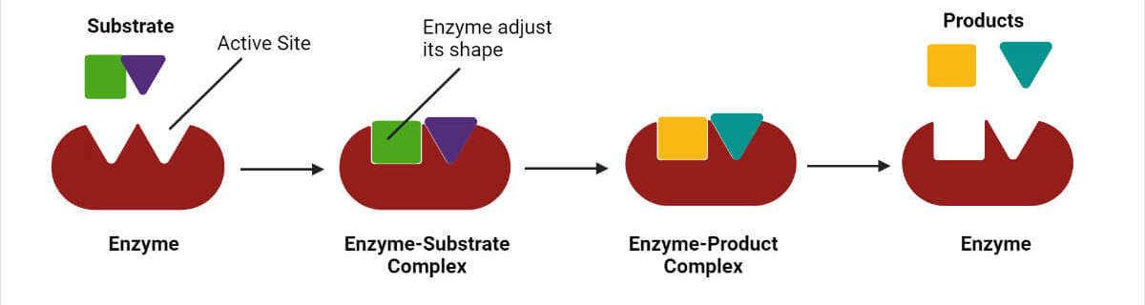
SHAPE COMPLEMENTARITY

Slide 47
ENTROPY VS ENTHALPY CONTRIBUTIONS
⚖️ Enthalpy: interactions like H-bonds and van der Waals
🔄 Entropy: flexibility and solvation effects
🧮 Overall binding free energy = ΔH - TΔS

Slide 48
SPECIFICITY VS AFFINITY
🎯 Specificity: how selectively a ligand binds
💪 Affinity: strength of binding
⚖️ High affinity does not guarantee specificity

Slide 49
ALLOSTERY AND COOPERATIVITY
🔄 Binding at one site can affect distant sites
⚡ Cooperativity: binding enhances or inhibits subsequent interactions
🧩 Important in multi-subunit proteins and regulation

Slide 50
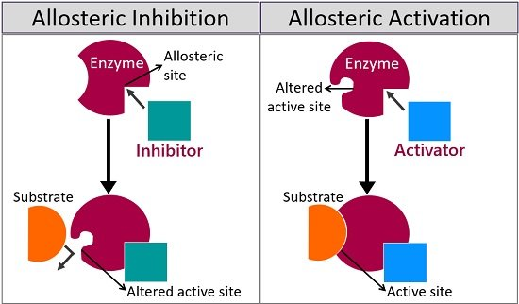
ALLOSTERY AND COOPERATIVITY

Slide 51
STRUCTURAL MOTIF
🧬 Common motifs: helix-turn-helix, zinc fingers, Rossmann fold
🎯 Motifs provide specific interaction patterns
💡 Recognition depends on both shape and chemistry

Slide 52
WATER AND ION MEDIATED INTERACTIONS
💧 Water can bridge ligand and target
⚡ Metal ions coordinate with ligands
🔍 Often critical in binding site architecture

Slide 53
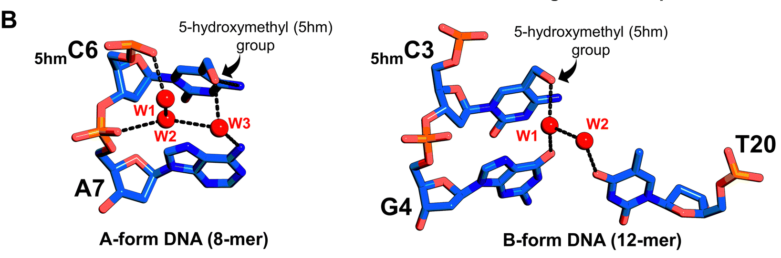
WATER AND ION MEDIATED INTERACTIONS

Slide 54
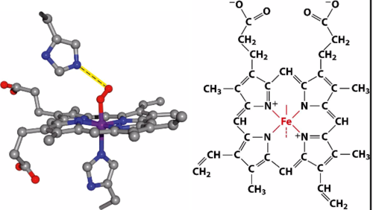
WATER AND ION MEDIATED INTERACTIONS

Slide 55
ALLOSTERIC VS ORTHOSTERIC BINDING
🔄 Orthosteric: primary active site
⚡ Allosteric: secondary site modulating function
🎯 Targeting allosteric sites can improve specificity

Slide 56
FRAGMENT-BASED BINDING
🧩 Ligands can be broken into fragments for analysis
🔗 Fragments may bind cooperatively
💡 Supports rational drug design and docking

Slide 57
BINDING POCKET CHARACTERIZATION
📏 Volume and shape define ligand compatibility
⚡ Electrostatic and hydrophobic maps guide binding
🔍 Used in scoring and virtual screening

Slide 58
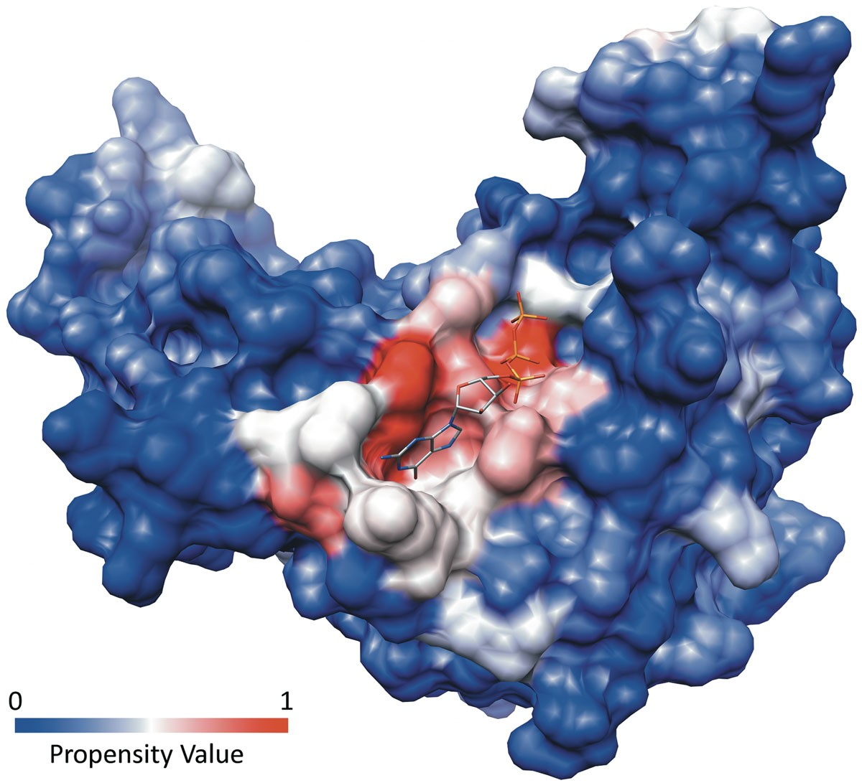
BINDING POCKET CHARACTERIZATION

Slide 59
OBJECTIVE FUNCTIONS IN DOCKING
🎯 Quantify fit and interaction energy
⚖️ Trade-offs between speed and accuracy
💻 Basis for ranking poses computationally

Slide 60
ACCURACY VS SPEED
⚡ Fast scoring may miss subtle interactions
🧮 Accurate calculations are computationally expensive
💡 Balance depends on application and dataset size

Slide 61
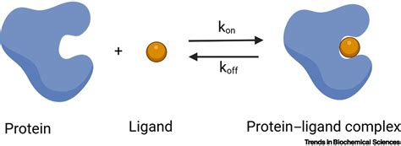
KD: ABSOLUTE BINDING CONSTANT

Slide 62
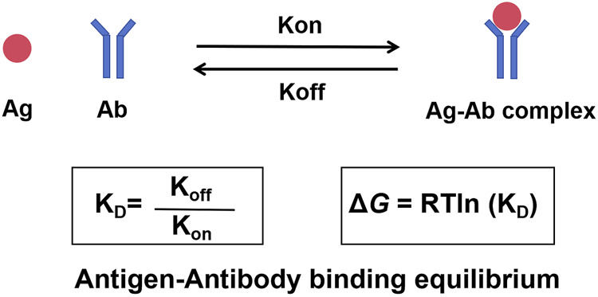
KD: ABSOLUTE BINDING CONSTANT

Slide 63
KD: ABSOLUTE BINDING CONSTANT
📏 Measures equilibrium binding strength
💡 Independent of experimental setup
🎯 Key reference for comparing ligands

Slide 64
IC50: CONTEXT-DEPENDENT MEASUREMENT
⚖️ Concentration needed to inhibit 50% of activity
🧪 Depends on assay conditions and substrate concentration
📊 Useful for relative comparisons

Slide 65
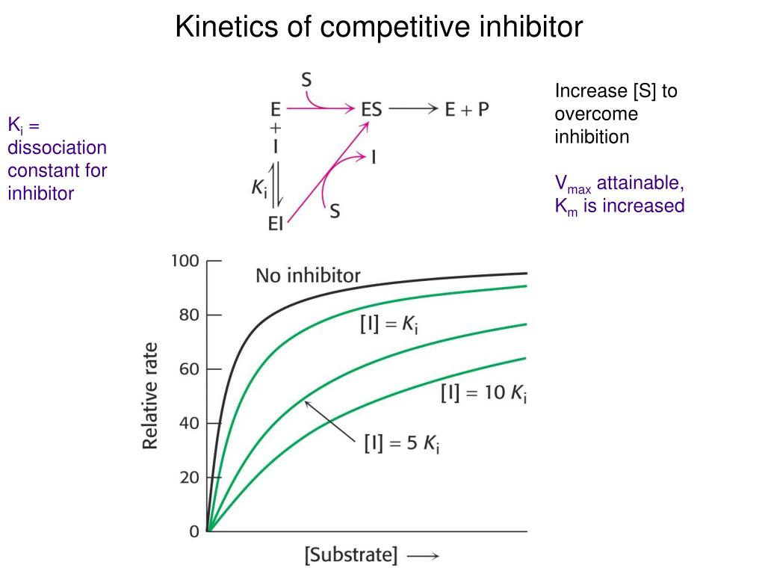
OTHER AFFINITY MEASURES: KI, EC50

Slide 66
OTHER AFFINITY MEASURES: KI, EC50
🔹 Ki: inhibition constant from enzyme kinetics
🔹 EC50: effective concentration for half-maximal response
⚖️ Each metric has context-specific interpretation

Slide 67
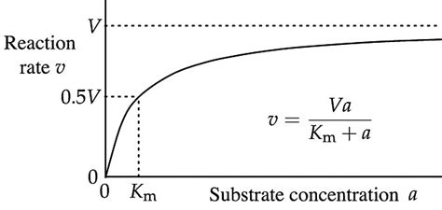
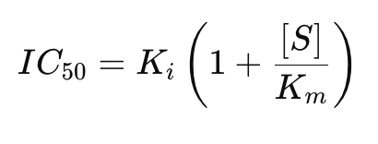
MICHAELIS-MENTEN KINETICS

Slide 68
EXPERIMENTAL VS PREDICTED AFFINITIES
🧪 Experimental values are ground truth
💻 Predictions are limited by model accuracy
⚠️ Important to validate computational results

Slide 69
LIMITATIONS OF CURRENT SOTA MODELS
⚠️ Docking scores often correlate poorly with actual affinity
💡 ML and deep learning improve predictions but have limitations
🔍 Experimental validation remains critical

Slide 70
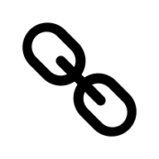
DOCKING AS A 3D OPTIMIZATION PROBLEM
🗻 Docking searches for optimal ligand position in 3D space
🎯 Goal: find binding pose with minimal energy
💻 Computationally challenging due to flexibility

Slide 71
POSE GENERATION VS SCORING
🔄 Generate multiple ligand conformations
⚖️ Score each pose to estimate binding affinity
💡 Both steps are critical for docking success

Slide 72
RIGID VS FLEXIBLE DOCKING
🧩 Rigid docking: fixed target and ligand
🔄 Flexible docking: accounts for conformational changes
⚖️ Flexibility improves realism but increases computation

Slide 73
PROTEIN FLEXIBILITY IN DOCKING
🌀 Side chains and backbone may adapt upon binding
💻 Techniques include ensemble docking and soft docking
🎯 Important for realistic prediction of poses

Slide 74
LIGAND FLEXIBILITY HANDLING
🔄 Multiple rotamers and torsions considered
⚖️ Conformer ensembles used to capture flexibility
💡 Critical for accurate docking scoring

Slide 75
CONFORMATIONAL SAMPLING STRATEGIES
🧮 Systematic or stochastic exploration of conformations
⚡ Monte Carlo, genetic algorithms, or distance geometry
🔍 Ensures low-energy poses are not missed

Slide 76
CONFORMATIONAL SPACE EXPLOSION
📈 Number of conformations grows exponentially with rotatable bonds
⚠️ Exhaustive search is often infeasible
💡 Sampling algorithms prioritize relevant regions

Slide 77
GRADIENT-BASED OPTIMIZATION
🖥️ Uses derivatives of energy with respect to coordinates
⚖️ Efficiently finds local minima
🔍 May miss global minimum due to energy landscape complexity

Slide 78
MONTE CARLO SAMPLING OF POSES
🎲 Randomly sample conformations
⚖️ Accept or reject moves based on energy criteria
💡 Useful for exploring diverse binding poses

Slide 79
SIMULATED ANNEALING
🔥 Gradually reduce “temperature” to escape local minima
⚡ Combines stochastic sampling with energy minimization
🧩 Effective for rugged energy landscapes

Slide 80
GENETIC ALGORITHMS IN DOCKING
🧬 Mimics evolution: selection, crossover, mutation
🎯 Identifies low-energy conformations
💻 Balances exploration and exploitation in search

Slide 81
COMBINING SAMPLING AND SCORING
⚖️ Sampling generates candidates; scoring ranks them
🔍 Iterative refinement improves pose prediction
💡 Integration critical for docking accuracy

Slide 82
ALPHAFOLD 3
🧬 Predicts protein 3D structure from sequence
🎯 Supports docking when experimental structures are unavailable
💻 High accuracy accelerates ligand binding studies

Slide 83
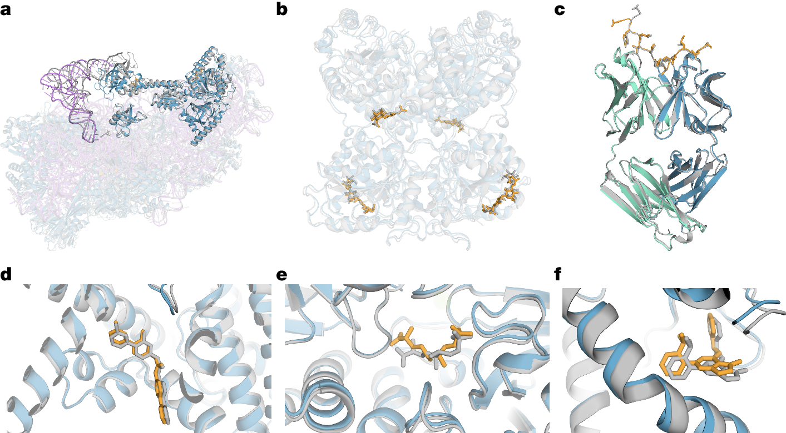
ALPHAFOLD 3

Slide 84
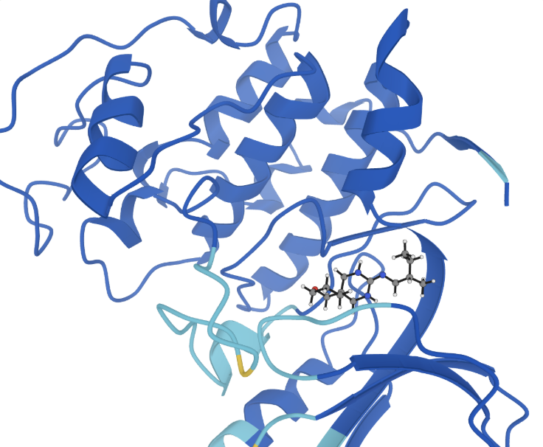
BOLTZ2

Slide 85
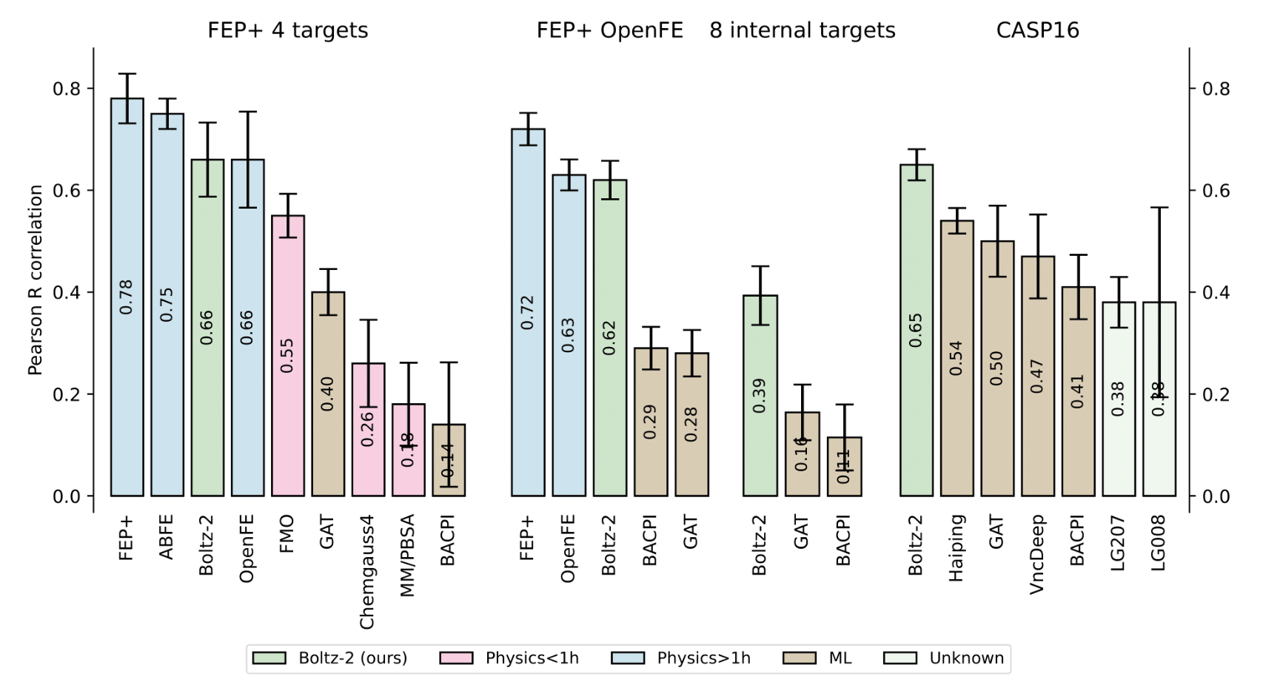
BOLTZ2

Slide 86
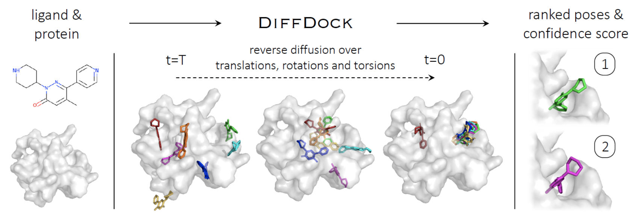
DIFFDOCK

Slide 87
DEEP DOCKING MODELS OVERVIEW
🤖 Predict ligand binding poses using neural networks
⚡ Accelerates virtual screening of large libraries
💡 Integrates with classical docking pipelines

Slide 88
LIMITATIONS OF DL MODELS
⚠️ Cannot reliably predict absolute binding energies
💡 Often require training on specific chemical space
🔍 Experimental validation still required

Slide 89
ML WITH CLASSICAL DOCKING
💻 ML improves sampling or rescoring
⚖️ Combines speed of ML with physics-based accuracy
🔍 Hybrid approaches increasingly common

Slide 90
INTERACTION FINGERPRINTS
📊 Encode ligand-target interactions as fingerprints
🔗 Identify recurring contact patterns
💡 Useful for comparing binding modes

Slide 91
ENERGY DECOMPOSITION APPROACHES
⚖️ Break total binding energy into component contributions
💡 Understand enthalpic vs entropic effects
🧮 Useful for rational ligand optimization

Slide 92
BINDING POCKET COMPARISON
📏 Compare shape and chemical properties of pockets
🎯 Identify conserved or unique interaction sites
💻 Supports virtual screening and docking design

Slide 93

LIGAND–TARGET BINDING
🗻 Binding explores complex energy landscapes
🔄 Multiple conformations must be considered
🎯 Optimization algorithms search for low-energy poses

Slide 94
3D STRUCTURE GENERATION
🔄 Molecules adopt multiple low-energy shapes
💡 Conformer ensembles improve docking and similarity analysis
🧬 Accurate 3D structures are essential for predictions

Slide 95
DOCKING
🎯 Pose generation + scoring = predicted binding affinity
⚖️ Trade-offs between speed and accuracy exist
💻 Algorithm choice affects docking success

Slide 96
REPRESENTATION CHOICES
📝 3D coordinates, distance matrices, fingerprints all matter
🔍 Structural similarity metrics influence docking evaluation
💡 Choosing the right representation improves predictions

Slide 97
CURRENT SOTA
🤖 ML and DL enhance docking and sampling
⚠️ Absolute binding affinities are still hard to predict
🔍 Experimental validation remains crucial

Slide 98
EXPERIMENTAL VALIDATION
🧪 Computational predictions guide but do not replace experiments
🔍 Confirm binding and affinity with assays like Kd, IC50
🎯 Iterative cycle of computation and experiment improves drug discovery

